Slide 1
Azure DevOps Hack
Shawn Weisfeld
Cloud Solution Architect
Microsoft

Slide 2


About Us
Shawn Weisfeld
Cloud Solution Architect
Microsoft – One Commercial Partner Technical Team
sweisfel@microsoft.com
Austin, TX
Peter Laudati
Cloud Solution Architect
Microsoft – One Commercial Partner Technical Team
Peter.Laudati@microsoft.com
Aberdeen, NJ

Slide 3
WHAT IS DEVOPS?

Slide 4

WHAT IS DEVOPS?
It’s a job title
It’s automation
It’s Development and Operations collaboration
It means faster and smaller releases

Slide 5
What is DevOps?
People. Process. Products.
Build& Test
Deploy
DevOps is the union of people, process, and products to enable continuous delivery of value to your end users.
“
Continuous Delivery
Develop
Operate
”
Plan & Track
Monitor & Learn

Slide 6


Slide 7
How Microsoft can help
Microsoft Azure is a powerful and flexible foundation for past, present, and future apps – easily build, manage, and deploy any application and any stack on a massive, global network using your favorite tools and frameworks.
Flexible
Powerful
Open
Choice of IaaS, PaaS, public cloud or hybrid.
Mirror or modernize app infrastructure with VMs, containers, microservices or serverless.
Supports all stages of the app modernization journey – from lift-and-shift to Cloud-Native.
Instantly improve the performance, scalability and resiliency of your apps by moving them to the cloud.
Increase business agility with Cloud-Native capabilities and built-in DevOps for continuous innovation.
Bring your stack, we bring a cloud that runs any app, on any platform, and any language.
Build applications using the language and tools of your choice - Azure supports what you already use and love so you can get up and running fast – just bring code.

Slide 8
What technologies do I need to support DevOps?
DevOps brings together people, processes, and products, automating software delivery to provide continuous value to your users. Using Azure DevOps, you can deliver software faster and more reliably - no matter how big your IT department or what tools you’re using.
Continuous integration (CI)
Improve software development quality and speed.
When you use Azure Pipeliens or Jenkins to build apps in the cloud and deploy to Azure, each time you commit code, it’s automatically built and tested and bugs are detected faster.
Continuous Deployment (CD)
By combining continuous integration and infrastructure as code (IaC), you’ll achieve identical deployments and the confidence to deploy to production at any time.
With continuous deployment, you can automate the entire process from code commit to production if your CI/CD tests are successful.
Continuous Learning & Monitoring
With Azure Application Insights you can identify how your applications are performing and test if the recent deployment made things better or worse.
Using CI/CD practices, paired with monitoring tools, you’ll be able to safely deliver features to your customers as soon as they’re ready.

Slide 9





Azure DevOps
Better together
Azure Boards
Azure Repos
Azure Pipelines
Azure Test Plans
Azure Artifacts
An end-to-end solution for organizations looking for an enterprise-grade toolchain
Fully Integrated with end to end traceability
Scalable to any team and project size
Highly available, multi region, hybrid cloud & on-prem
Customer Support
Consistent admin and access control
➔
https://azure.com/devops

Slide 10



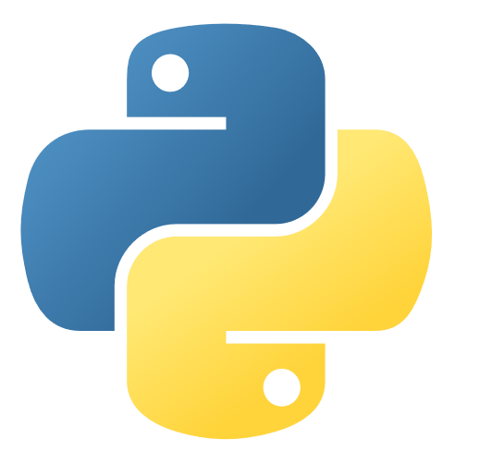











Azure DevOps: Choose what you love
Any Language, Any Platform
Azure DevOps lets developers choose the tools and languages that are right for them
Mix and match to create workflows with tools from Microsoft, open source or your favorite 3rd party tools
Target any cloud, on-prem or both and deploy to the servers you need

Slide 11
Demo
Notes:
Demo : dev.azure.com

Slide 12
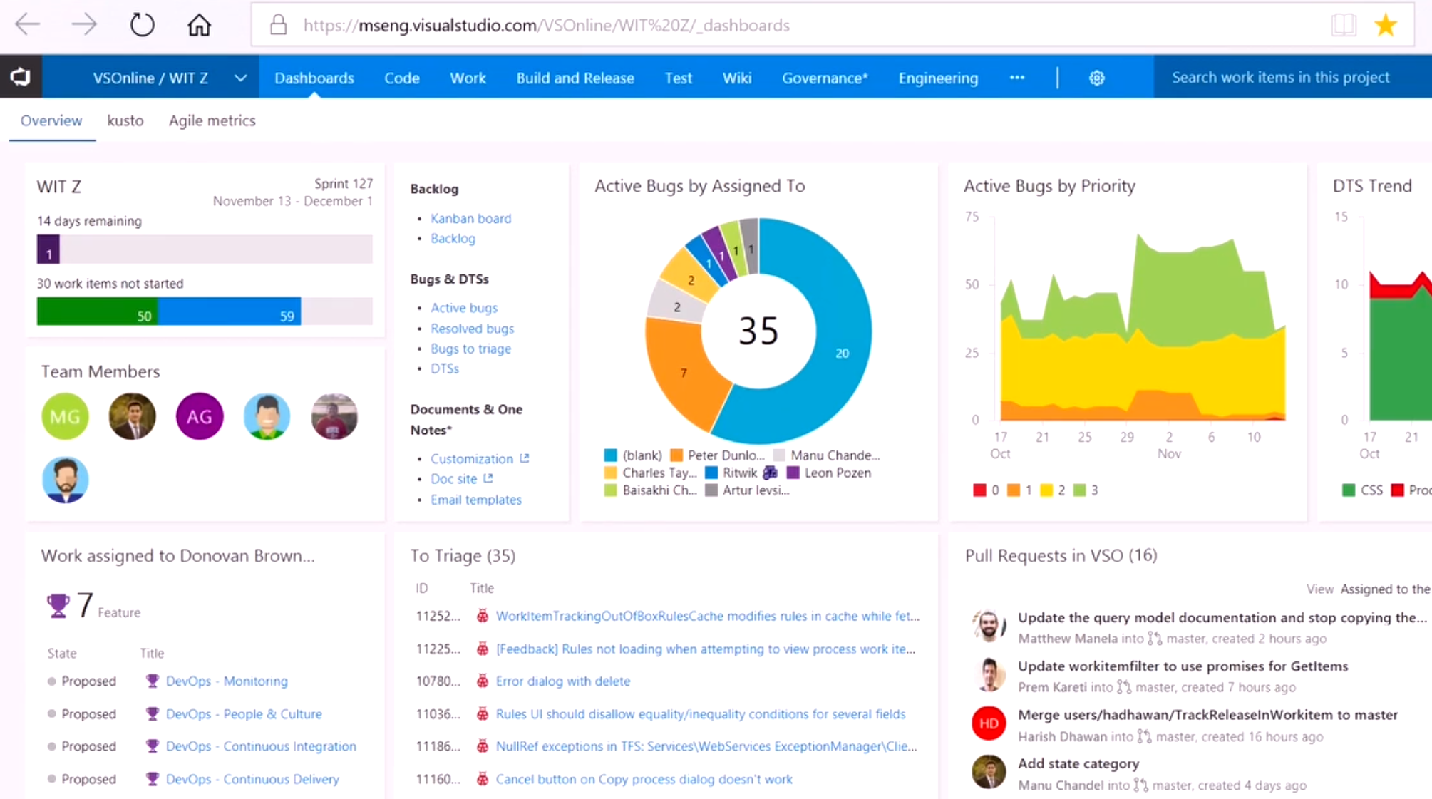


DevOps at Microsoft
DevOps at Scale
Visual Studio Team Services is the toolchain of choice for Microsoft engineering
+85,000
Engineers at Microsoft are using VSTS
Windows Engineering Team
VSTS Engineering Team
VSTS scales to host the world’s largest Git repo
Embracing DevOps practices = More value to customers
300GB Source code
More features delivered to customers in 2016 than in previous 4 years combined
3.5M Files
4,000+ Devs
http://aka.ms/devopsatmicrosoft

Slide 13
Resources
Azure DevOps YouTube Channel – See It
https://www.youtube.com/channel/UC-ikyViYMM69joIAv7dlMsA
Azure DevOps Hands-On Labs – Do It
https://www.azuredevopslabs.com/
Azure DevOps Documentation – Read about It
https://docs.microsoft.com/en-us/azure/devops
Azure DevOps Projects- Get Started Fast
https://azure.microsoft.com/en-us/features/devops-projects/

Slide 14
Format
Challenges are cumulative, building upon each other.
Establish Confidence – start small and simple (think hello world)
Build Competence – by having successively more complex challenges
Challenges are NOT step-by-step hands on labs!
No “clicking here” or “copy n pasting there”
Challenge definitions are short. A couple of sentences or bullet points stating the end goal(s) and perhaps a hint at the skill(s) needed.
You MUST work together as a team to figure out how to complete them!

Slide 15
Format
For each challenge we will deliver a ”mini-lecture” explaining concepts in it.
We’ll review results for each challenge when it looks like a majority of folks have completed the challenge
Don’t be beholden by the clock!
Move quickly or take it slow.
Your proctors are here to help you.
There WILL be more challenges than you can complete in our allotted time!
These are takeaways for follow up at home or with customers!

Slide 16
Proctors
Each team will have a proctor through-out the whole hack.
Use them! But don’t expect them to give you all the answers.
Get to know your proctor, their likes and dislikes...
All the better to find a bribe that works!
Notes:
Keep the teams working as teams!
Encourage all to “learn from” and “share with” each other!
If you observe individuals racing ahead, encourage them to help those who are behind.
Encourage attendees to use their team’s channel on MS Teams to collaborate/share info!
Unblock teams who get stuck
Encourage team members to unblock each other first!
Provide hints, but not answers
If you observe individuals stuck for a while, help them get moving so they don’t lose interest.
Provide hints/pointers to the teams on how to solve problems & where to find information.
Use the answers/solutions in the proctor’s guide, but don’t share with the attendees
Proctor’s guide won’t be comprehensive. As SMEs, proctors should use their knowledge to help with solution hints/ideas.
Notify the emcee of unexpected blockers that arise during the event so they can be communicated to all, and recorded for future reference.

Slide 17
Tooling
You can use any tooling you want, but we strongly encourage (and will only support the following):
Azure DevOps Portal
Visual Studio Code

Slide 18
Finding Answers
Search engines are your friend! Azure is a hot technology and much ink has been spilled on it.
The Azure docs are your best bet.
Many of the related open source projects used here have top notch documentation!

Slide 19
TIPS
An InPrivate/Incognito browser can solve many authentication issues.
Re-read the instructions there are lots of clues.

Slide 20
Let’s Get Hacking
Go to http://aka.ms/20190801AzureDevOpsHack
Start on Challenge 1 if you have completed Challenge 0
If you have NOT completed Challenge 0 let us know

